Slide 1
Chapter 2 Elementary Programming

Slide 2
Motivations
In the preceding chapter, you learned how to create, compile, and run a Java program. Starting from this chapter, you will learn how to solve practical problems programmatically. Through these problems, you will learn Java primitive data types and related subjects, such as variables, constants, data types, operators, expressions, and input and output.

Slide 3
Objectives
To write Java programs to perform simple computations (§2.2).
To obtain input from the console using the Scanner class (§2.3).
To use identifiers to name variables, constants, methods, and classes (§2.4).
To use variables to store data (§§2.5–2.6).
To program with assignment statements and assignment expressions (§2.6).
To use constants to store permanent data (§2.7).
To name classes, methods, variables, and constants by following their naming conventions (§2.8).
To explore Java numeric primitive data types: byte, short, int, long, float, and double (§2.9.1).
To read a byte, short, int, long, float, or double value from the keyboard (§2.9.2).
To perform operations using operators +, -, *, /, and % (§2.9.3).
To perform exponent operations using Math.pow(a, b) (§2.9.4).
To write integer literals, floating-point literals, and literals in scientific notation (§2.10).
To write and evaluate numeric expressions (§2.11).
To obtain the current system time using System.currentTimeMillis() (§2.12).
To use augmented assignment operators (§2.13).
To distinguish between postincrement and preincrement and between postdecrement and predecrement (§2.14).
To cast the value of one type to another type (§2.15).
To describe the software development process and apply it to develop the loan payment program (§2.16).
To write a program that converts a large amount of money into smaller units (§2.17).
To avoid common errors and pitfalls in elementary programming (§2.18).

Slide 4
Introducing Programming with an Example
Listing 2.1 Computing the Area of a Circle
This program computes the area of the circle.
ComputeArea
Note: Clicking the green button displays the source code with interactive animation. You can also run the code in a browser. Internet connection is needed for this button.
Run
Note: Clicking the blue button runs the code from Windows. If you cannot run the buttons, see
IMPORTANT NOTE: If you cannot run the buttons, see liveexample.pearsoncmg.com/slide/javaslidenote.doc.

Slide 5
Trace a Program Execution
animation
allocate memory for radius
public class ComputeArea {
/** Main method */
public static void main(String[] args) {
double radius;
double area;
// Assign a radius
radius = 20;
// Compute area
area = radius * radius * 3.14159;
// Display results
System.out.println("The area for the circle of radius " +
radius + " is " + area);
}
}
radius
no value

Slide 6
Trace a Program Execution
animation
public class ComputeArea {
/** Main method */
public static void main(String[] args) {
double radius;
double area;
// Assign a radius
radius = 20;
// Compute area
area = radius * radius * 3.14159;
// Display results
System.out.println("The area for the circle of radius " +
radius + " is " + area);
}
}
memory
radius
no value
area
no value
allocate memory for area

Slide 7
Trace a Program Execution
animation
public class ComputeArea {
/** Main method */
public static void main(String[] args) {
double radius;
double area;
// Assign a radius
radius = 20;
// Compute area
area = radius * radius * 3.14159;
// Display results
System.out.println("The area for the circle of radius " +
radius + " is " + area);
}
}
assign 20 to radius
radius
20
area
no value

Slide 8
Trace a Program Execution
animation
public class ComputeArea {
/** Main method */
public static void main(String[] args) {
double radius;
double area;
// Assign a radius
radius = 20;
// Compute area
area = radius * radius * 3.14159;
// Display results
System.out.println("The area for the circle of radius " +
radius + " is " + area);
}
}
memory
radius
20
area
1256.636
compute area and assign it to variable area

Slide 9

Trace a Program Execution
animation
public class ComputeArea {
/** Main method */
public static void main(String[] args) {
double radius;
double area;
// Assign a radius
radius = 20;
// Compute area
area = radius * radius * 3.14159;
// Display results
System.out.println("The area for the circle of radius " +
radius + " is " + area);
}
}
memory
radius
20
area
1256.636
print a message to the console

Slide 10
☑ Check Point
Identify and fix the errors in the following code: 1 public class Test { 2 public void main(string[] args) { 3 double i = 50.0; 4 double k = i + 50.0; 5 double j = k + 1; 6 7 System.out.println("j is " + j + " and 8 k is " + k); 9 } 10 }
<--- ANSWER --->
Line 2: Missing static for the main method. Line 2: string should be String. Lines 7-8: The string cannot be broken into two lines.

Slide 11
Reading Input from the Console
1. Create a Scanner object
Scanner input = new Scanner(System.in);
2. Use the method nextDouble() to obtain to a double value. For example,
System.out.print("Enter a double value: ");
Scanner input = new Scanner(System.in);
double d = input.nextDouble();
ComputeAreaWithConsoleInput
Run
ComputeAverage
Run

Slide 12
Implicit Import and Explicit Import
java.util.* ; // Implicit import
java.util.Scanner; // Explicit Import
No performance difference

Slide 13
☑ Check Point
How do you write a statement to let the user enter a double value from the keyboard? What happens if you entered 5a when executing the following code? double radius = input.nextDouble();
<--- ANSWER --->
Use Scanner input = new Scanner(System.in); double value = input.nextDouble(); A runtime error will occur if you entered 5a when executing the following code: double radius = input.nextDouble();

Slide 14
☑ Check Point
Are there any performance differences between the following two import statements? import java.util.Scanner; import java.util.*;
<--- ANSWER --->
No

Slide 15
Identifiers
An identifier is a sequence of characters that consist of letters, digits, underscores (_), and dollar signs ($).
An identifier must start with a letter, an underscore (_), or a dollar sign ($). It cannot start with a digit.
An identifier cannot be a reserved word. (See Appendix A, “Java Keywords,” for a list of reserved words).
An identifier cannot be true, false, or null.
An identifier can be of any length.

Slide 16
Variables
// Compute the first area
radius = 1.0;
area = radius * radius * 3.14159;
System.out.println("The area is “ + area + " for radius "+radius);
// Compute the second area
radius = 2.0;
area = radius * radius * 3.14159;
System.out.println("The area is “ + area + " for radius "+radius);

Slide 17
☑ Check Point
Which of the following identifiers are valid? Which are Java keywords? miles, Test, a++, --a, 4#R, $4, #44, apps class, public, int, x, y, radius
<--- ANSWER --->
Valid identifiers: miles, Test, $4, apps, x, y, radius Invalid identifiers: a++, --a, 4#R, #44, class, public, int Keywords: class, public, int

Slide 18
Declaring Variables
int x; // Declare x to be an
// integer variable;
double radius; // Declare radius to
// be a double variable;
char a; // Declare a to be a
// character variable;

Slide 19
Assignment Statements
x = 1; // Assign 1 to x;
radius = 1.0; // Assign 1.0 to radius;
a = 'A'; // Assign 'A' to a;

Slide 20
☑ Check Point
Identify and fix the errors in the following code: 1 public class Test { 2 public static void main(String[] args) { 3 int i = k + 2; 4 System.out.println(i); 5 } 6 }
<--- ANSWER --->
Line 3: k is undefined.

Slide 21
Declaring and Initializing in One Step
int x = 1;
double d = 1.4;

Slide 22
☑ Check Point
Identify and fix the errors in the following code: 1 public class Test { 2 public static void main(String[] args) { 3 int i = j = k = 2; 4 System.out.println(i + " " + j + " " + k); 5 } 6 }
<--- ANSWER --->
Note that the statement int i = j = k = 2 in line 3 only declares i. j and k are not declared. The following line would declare i, j, and k: int i, j, k; To fix the error, change line 3 to int j, k; int i = j = k = 2; or int i = 2; int j = 2; int k = 2; or int i = 2, j = 2, k = 2;

Slide 23
Named Constants
final datatype CONSTANTNAME = VALUE;
final double PI = 3.14159;
final int SIZE = 3;

Slide 24
☑ Check Point
What are the benefits of using constants? Declare an int constant SIZE with value 20.
<--- ANSWER --->
There are three benefits of using constants: (1) you do not have to repeatedly type the same value; (2) the value can be changed in a single location, if necessary; (3) the program is easy to read. final int SIZE = 20;

Slide 25
☑ Check Point
Translate the following algorithm into Java code: Step 1: Declare a double variable named miles with initial value 100. Step 2: Declare a double constant named KILOMETERS_PER_MILE with value 1.609. Step 3: Declare a double variable named kilometers, multiply miles and KILOMETERS_PER_MILE, and assign the result to kilometers. Step 4: Display kilometers to the console. What is kilometers after Step 4?
<--- ANSWER --->
double miles = 100; final double KILOMETERS_PER MILE = 1.609; double kilometers = KILOMETERS_PER MILE * miles; System.out.println(kilometers); The value of kilometers is 160.9.

Slide 26
Naming Conventions
Choose meaningful and descriptive names.
Variables and method names:
Use lowercase. If the name consists of several words, concatenate all in one, use lowercase for the first word, and capitalize the first letter of each subsequent word in the name. For example, the variables radius and area, and the method computeArea.

Slide 27
Naming Conventions, cont.
Class names:
Capitalize the first letter of each word in the name. For example, the class name ComputeArea.
Constants:
Capitalize all letters in constants, and use underscores to connect words. For example, the constant PI and MAX_VALUE

Slide 28
☑ Check Point
What are the naming conventions for class names, method names, constants, and variables?
Which of the following items can be a constant, a method, a variable, or a class according to the Java naming conventions? MAX_VALUE, read, readDouble, Test
<--- ANSWER --->
Class names: Capitalize the first letter in each name. Variables and method names: Lowercase the first word, capitalize the first letter in all subsequent words. Constants: Capitalize all letters.
Constant: MAX_VALUE Method or variable: read , readDouble Class name: Test

Slide 29
Numerical Data Types

Slide 30
Reading Numbers from the Keyboard
Scanner input = new Scanner(System.in);
int value = input.nextInt();

Slide 31
Numeric Operators

Slide 32
Integer Division
+, -, *, /, and %
5 / 2 yields an integer 2.
5.0 / 2 yields a double value 2.5
5 % 2 yields 1 (the remainder of the division)

Slide 33
Remainder Operator
Remainder is very useful in programming. For example, an even number % 2 is always 0 and an odd number % 2 is always 1. So you can use this property to determine whether a number is even or odd. Suppose today is Saturday and you and your friends are going to meet in 10 days. What day is in 10 days? You can find that day is Tuesday using the following expression:

Slide 34
Problem: Displaying Time
Write a program that obtains minutes and remaining seconds from seconds.
DisplayTime
Run

Slide 35
NOTE
Calculations involving floating-point numbers are approximated because these numbers are not stored with complete accuracy. For example,
System.out.println(1.0 - 0.1 - 0.1 - 0.1 - 0.1 - 0.1);
displays 0.5000000000000001, not 0.5, and
System.out.println(1.0 - 0.9);
displays 0.09999999999999998, not 0.1. Integers are stored precisely. Therefore, calculations with integers yield a precise integer result.

Slide 36
Exponent Operations
System.out.println(Math.pow(2, 3));
// Displays 8.0
System.out.println(Math.pow(4, 0.5));
// Displays 2.0
System.out.println(Math.pow(2.5, 2));
// Displays 6.25
System.out.println(Math.pow(2.5, -2));
// Displays 0.16

Slide 37
☑ Check Point
Find the largest and smallest byte, short, int, long, float, and double. Which of these data types requires the least amount of memory?
<--- ANSWER --->
For byte, from -128 to 127, inclusive. For short, from -32768 to 32767, inclusive. For int, from -2147483648 to 2147483647, inclusive. For long, from -9223372036854775808 to 9223372036854775807. For float, the smallest positive float is 1.40129846432481707e-45 and the largest float is 3.40282346638528860e+38. For double, the smallest positive double is 4.94065645841246544e-324 and the largest double is 1.79769313486231570e+308d.

Slide 38
☑ Check Point
Show the result of the following remainders. 56 % 6 78 % -4 -34 % 5 -34 % -5 5 % 1 1 % 5
<--- ANSWER --->
2 2 -4 -4 0 1

Slide 39
☑ Check Point
If today is Tuesday, what will be the day in 100 days?
<--- ANSWER --->
(2 + 100) % 7 = 4. So, it is Thursday.

Slide 40
☑ Check Point
What is the result of 25 / 4?
How would you rewrite the expression if you wished the result to be a floating-point number?
<--- ANSWER --->
25 / 4 is 6.
If you want the quotient to be a floating-point number, rewrite it as 25.0 / 4.0, 25.0 / 4, or 25 / 4.0.

Slide 41
☑ Check Point
Show the result of the following code: System.out.println(2 * (5 / 2 + 5 / 2)); System.out.println(2 * 5 / 2 + 2 * 5 / 2); System.out.println(2 * (5 / 2)); System.out.println(2 * 5 / 2);
<--- ANSWER --->
8 10 4 5

Slide 42
☑ Check Point
Are the following statements correct? If so, show the output. System.out.println("25 / 4 is " + 25 / 4); System.out.println("25 / 4.0 is " + 25 / 4.0); System.out.println("3 * 2 / 4 is " + 3 * 2 / 4); System.out.println("3.0 * 2 / 4 is " + 3.0 * 2 / 4);
<--- ANSWER --->
Yes, the statements are correct. The output is 25 / 4 is 6 25 / 4.0 is 6.25 3 * 2 / 4 is 1 3.0 * 2 / 4 is 1.5

Slide 43
☑ Check Point
Write a statement to display the result of 2^{3.5}.
<--- ANSWER --->
Math.pow(2, 3.5)

Slide 44
☑ Check Point
Suppose m and r are integers. Write a Java expression for mr² to obtain a floating-point result.
<--- ANSWER --->
1.0 * m * (r * r)

Slide 45
Number Literals
A literal is a constant value that appears directly in the program. For example, 34, 1,000,000, and 5.0 are literals in the following statements:
int i = 34;
long x = 1000000;
double d = 5.0;

Slide 46
Integer Literals
An integer literal can be assigned to an integer variable as long as it can fit into the variable. A compilation error would occur if the literal were too large for the variable to hold. For example, the statement byte b = 1000 would cause a compilation error, because 1000 cannot be stored in a variable of the byte type.
An integer literal is assumed to be of the int type, whose value is between -2³¹ (-2147483648) to 2³¹–1 (2147483647). To denote an integer literal of the long type, append it with the letter L or l. L is preferred because l (lowercase L) can easily be confused with 1 (the digit one).

Slide 47
Floating-Point Literals
Floating-point literals are written with a decimal point. By default, a floating-point literal is treated as a double type value. For example, 5.0 is considered a double value, not a float value. You can make a number a float by appending the letter f or F, and make a number a double by appending the letter d or D. For example, you can use 100.2f or 100.2F for a float number, and 100.2d or 100.2D for a double number.

Slide 48
double vs. float
The double type values are more accurate than the float type values. For example,
System.out.println("1.0 / 3.0 is " + 1.0 / 3.0);
System.out.println("1.0F / 3.0F is " + 1.0F / 3.0F);

Slide 49
Scientific Notation
Floating-point literals can also be specified in scientific notation, for example, 1.23456e+2, same as 1.23456e2, is equivalent to 123.456, and 1.23456e-2 is equivalent to 0.0123456. E (or e) represents an exponent and it can be either in lowercase or uppercase.

Slide 50
☑ Check Point
How many accurate digits are stored in a float or double type variable?
<--- ANSWER --->
A float value has 7-8 number of accurate digits and a double value has 15-17 number of accurate digits.

Slide 51
☑ Check Point
Which of the following are correct literals for floating-point numbers? 12.3, 12.3e+2, 23.4e-2, -334.4, 20.5, 39F, 40D
<--- ANSWER --->
All can be used as literals for floating-point numbers.

Slide 52
☑ Check Point
Which of the following are the same as 52.534? 5.2534e+1, 0.52534e+2, 525.34e-1, 5.2534e+0
<--- ANSWER --->
5.2534e+1, 0.52534e+2, 525.34e-1 are the same as 52.534.

Slide 53
☑ Check Point
Which of the following are correct literals? 5_2534e+1, _2534, 5_2, 5_
<--- ANSWER --->
5_2534e+1, and 5_2, are correct.

Slide 54
Arithmetic Expressions
is translated to
(3+4*x)/5 – 10*(y-5)*(a+b+c)/x + 9*(4/x + (9+x)/y)

Slide 55
How to Evaluate an Expression
Though Java has its own way to evaluate an expression behind the scene, the result of a Java expression and its corresponding arithmetic expression are the same. Therefore, you can safely apply the arithmetic rule for evaluating a Java expression.

Slide 56
Problem: Converting Temperatures
Write a program that converts a Fahrenheit degree to Celsius using the formula:
Note: you have to write
celsius = (5.0 / 9) * (fahrenheit – 32)
FahrenheitToCelsius
Run

Slide 57


☑ Check Point
How would you write the following arithmetic expression in Java?
<--- ANSWER --->
4.0 / (3 * (r + 34)) - 9.0 * (a + b * c) + (3 + d * (2 + a) )/ (a + b * d)
5.5 * Math.pow(r + 2.5, 2.5 + t)
$$\frac{4}{3(r+34)}−9\left(a+bc\right)+\frac{3+d(2+a)}{a+bd}$$
$$5.5∗{(r+2.5)}^{2.5+t}$$

Slide 58
Problem: Displaying Current Time
Write a program that displays current time in GMT in the format hour:minute:second such as 1:45:19.
The currentTimeMillis method in the System class returns the current time in milliseconds since the midnight, January 1, 1970 GMT. (1970 was the year when the Unix operating system was formally introduced.) You can use this method to obtain the current time, and then compute the current second, minute, and hour as follows.
ShowCurrentTime
Run

Slide 59
☑ Check Point
How do you obtain the current second, minute, and hour?
<--- ANSWER --->
long totalMills = System.currentTimeMillis() returns the milliseconds since Jan 1, 1970. long totalSeconds = totalMills / 1000 returns the total seconds. long totalMinutes = totalSeconds / 60 returns the total minutes. totalSeconds % 60 returns the current second. totalMinutes % 60 returns the current minute. totalMinutes / 60 % 24 returns the current hour.

Slide 60
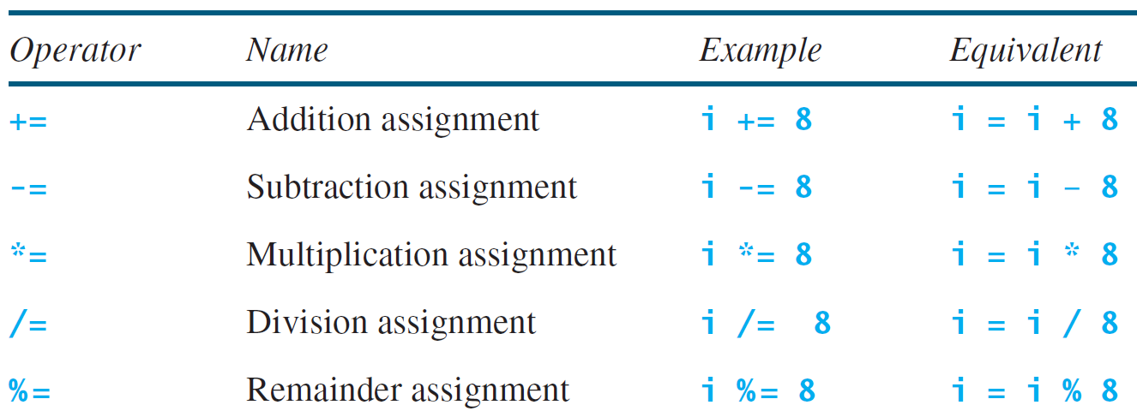
Augmented Assignment Operators

Slide 61
☑ Check Point
Show the output of the following code: double a = 6.5; a += a + 1; System.out.println(a); a = 6; a /= 2; System.out.println(a);
<--- ANSWER --->
14.0 3.0 Hint: a += a + 1 is a += 6.5 + 1, a += 7.5, a = a + 7.5, a = 6.5 + 7.5. Therefore, a is 14.0.

Slide 62
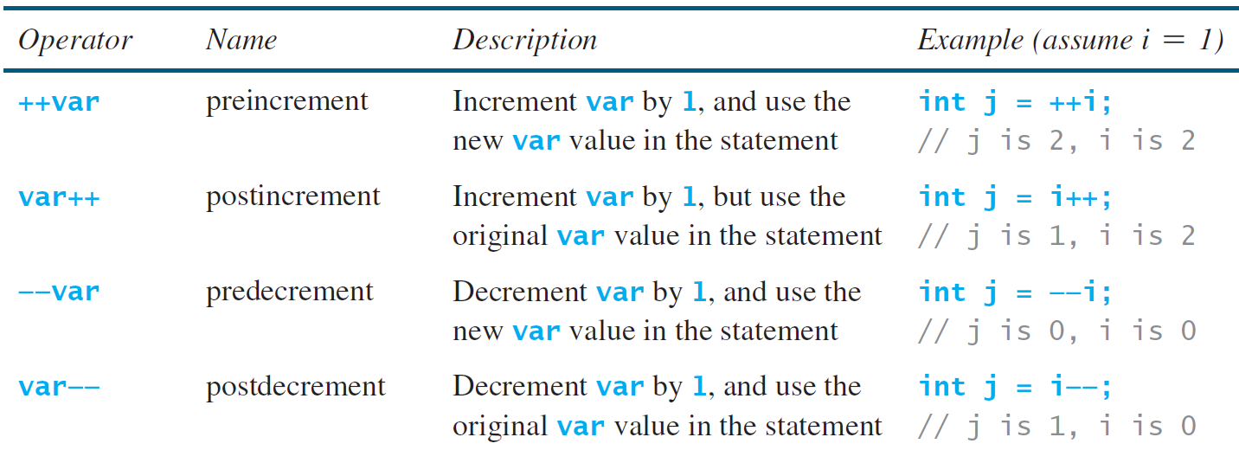
Increment and Decrement Operators

Slide 63
Increment and Decrement Operators, cont.

Slide 64
Increment and Decrement Operators, cont.
Using increment and decrement operators makes expressions short, but it also makes them complex and difficult to read. Avoid using these operators in expressions that modify multiple variables, or the same variable for multiple times such as this: int k = ++i + i.

Slide 65
Assignment Expressions and Assignment Statements
Prior to Java 2, all the expressions can be used as statements. Since Java 2, only the following types of expressions can be statements:
variable op= expression; // Where op is +, -, *, /, or %
++variable;
variable++;
--variable;
variable--;

Slide 66
☑ Check Point
Which of these statements are true? a) Any expression can be used as a statement. b) The expression x++ can be used as a statement. c) The statement x = x + 5 is also an expression. d) The statement x = y = x = 0 is illegal.
<--- ANSWER --->
b and c are true.

Slide 67
☑ Check Point
Show the output of the following code: int a = 6; int b = a++; System.out.println(a); System.out.println(b); a = 6; b = ++a; System.out.println(a); System.out.println(b);
<--- ANSWER --->
7 6 7 7

Slide 68
Numeric Type Conversion
Consider the following statements:
byte i = 100;
long k = i * 3 + 4;
double d = i * 3.1 + k / 2;

Slide 69
Conversion Rules
When performing a binary operation involving two operands of different types, Java automatically converts the operand based on the following rules:
1. If one of the operands is double, the other is converted into double.
2. Otherwise, if one of the operands is float, the other is converted into float.
3. Otherwise, if one of the operands is long, the other is converted into long.
4. Otherwise, both operands are converted into int.

Slide 70
Type Casting
Implicit casting
double d = 3; (type widening)
Explicit casting
int i = (int)3.0; (type narrowing)
int i = (int)3.9; (Fraction part is truncated)
What is wrong? int x = 5 / 2.0;

Slide 71
Problem: Keeping Two Digits After Decimal Points
Write a program that displays the sales tax with two digits after the decimal point.
SalesTax
Run

Slide 72
Casting in an Augmented Expression
In Java, an augmented expression of the form x1 op= x2 is implemented as x1 = (T)(x1 op x2), where T is the type for x1. Therefore, the following code is correct.
int sum = 0;
sum += 4.5; // sum becomes 4 after this statement
sum += 4.5 is equivalent to sum = (int)(sum + 4.5).

Slide 73
☑ Check Point
Can different types of numeric values be used together in a computation?
<--- ANSWER --->
Yes. Different types of numeric values can be used in the same computation through numeric conversions referred to as casting.

Slide 74
☑ Check Point
What does an explicit casting «from a double to an int» do with the fractional part of the double value?
Does casting change the variable being cast?
<--- ANSWER --->
The fractional part is truncated.
Casting does not change the variable being cast.

Slide 75
☑ Check Point
Show the output of the following code: float f = 12.5F; int i = (int)f; System.out.println("f is " + f); System.out.println("i is " + i);
<--- ANSWER --->
f is 12.5 i is 12

Slide 76
☑ Check Point
If you change (int)(tax * 100) / 100.0 to (int)(tax * 100) / 100 in line 11, what will be the output for the input purchase amount of 197.556? 1 import java.util.Scanner; 2 3 public class SalesTax { 4 public static void main(String[] args) { 5 Scanner input = new Scanner(System.in); 6 7 System.out.print("Enter purchase amount: "); 8 double purchaseAmount = input.nextDouble(); 9 10 double tax = purchaseAmount * 0.06; 11 System.out.println("Sales tax is $" + (int)(tax * 100) / 100.0); 12 } 13 }
<--- ANSWER --->
The answer is 11 Here is the reason: tax = purchaseAmount * 0.06 = 197.556 * 0.06 = 11.85336 tax * 100 = 1185.336 (int)(tax * 100) = 1185 1185/ 100 = 11

Slide 77
☑ Check Point
Show the output of the following code: double amount = 5; System.out.println(amount / 2); System.out.println(5 / 2);
<--- ANSWER --->
2.5 2

Slide 78
☑ Check Point
Write an expression that rounds a double value in variable d to an integer.
<--- ANSWER --->
(int)(d + 0.5)

Slide 79
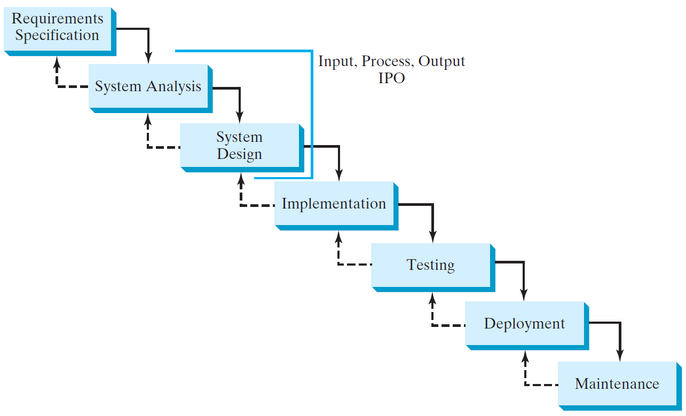
Software Development Process

Slide 80
Requirement Specification
A formal process that seeks to understand the problem and document in detail what the software system needs to do. This phase involves close interaction between users and designers.
Most of the examples in this book are simple, and their requirements are clearly stated. In the real world, however, problems are not well defined. You need to study a problem carefully to identify its requirements.

Slide 81
System Analysis
Seeks to analyze the business process in terms of data flow, and to identify the system’s input and output.
Part of the analysis entails modeling the system’s behavior. The model is intended to capture the essential elements of the system and to define services to the system.

Slide 82
System Design
The process of designing the system’s components.
This phase involves the use of many levels of abstraction to decompose the problem into manageable components, identify classes and interfaces, and establish relationships among the classes and interfaces.

Slide 83
IPO
The essence of system analysis and design is input, process, and output. This is called IPO.

Slide 84
Implementation
The process of translating the system design into programs. Separate programs are written for each component and put to work together.
This phase requires the use of a programming language like Java. The implementation involves coding, testing, and debugging.

Slide 85
Testing
Ensures that the code meets the requirements specification and weeds out bugs.
An independent team of software engineers not involved in the design and implementation of the project usually conducts such testing.

Slide 86
Deployment
Deployment makes the project available for use.
For a Java program, this means installing it on a desktop or on the Web.

Slide 87
Maintenance
Maintenance is concerned with changing and improving the product.
A software product must continue to perform and improve in a changing environment. This requires periodic upgrades of the product to fix newly discovered bugs and incorporate changes.

Slide 88
Problem: Computing Loan Payments
This program lets the user enter the interest rate, number of years, and loan amount, and computes monthly payment and total payment.
ComputeLoan
Run

Slide 89

☑ Check Point
How would you write the following arithmetic expression?
<--- ANSWER --->
(-b + Math.pow(b * b - 4 * a * c, 0.5)) / (2 * a)
$$\frac{−b+\sqrt{b^{2}−4ac}}{2a}$$

Slide 90
Problem: Monetary Units
This program lets the user enter the amount in decimal representing dollars and cents and output a report listing the monetary equivalent in single dollars, quarters, dimes, nickels, and pennies. Your program should report maximum number of dollars, then the maximum number of quarters, and so on, in this order.
ComputeChange
Run

Slide 91
☑ Check Point
1 import java.util.Scanner;
2
3 public class ComputeChange {
4 public static void main(String[] args) {
5 // Create a Scanner
6 Scanner input = new Scanner(System.in);
7
8 // Receive the amount
9 System.out.print(
10 "Enter an amount in double, for example 11.56: ");
11 double amount = input.nextDouble();
12
13 int remainingAmount = (int)(amount * 100);
14
15 // Find the number of one dollars
16 int numberOfOneDollars = remainingAmount / 100;
17 remainingAmount = remainingAmount % 100;
18
19 // Find the number of quarters in the remaining amount
20 int numberOfQuarters = remainingAmount / 25;
21 remainingAmount = remainingAmount % 25;
22
23 // Find the number of dimes in the remaining amount
24 int numberOfDimes = remainingAmount / 10;
25 remainingAmount = remainingAmount % 10;
26
27 // Find the number of nickels in the remaining amount
28 int numberOfNickels = remainingAmount / 5;
29 remainingAmount = remainingAmount % 5;
30
Show the output with the input value 1.99.
<--- ANSWER --->
Enter an amount in double, for example 11.56: 1.99 Your amount 1.99 consists of 1 dollars 3 quarters 2 dimes 0 nickels 4 pennies
31 // Find the number of pennies in the remaining amount
32 int numberOfPennies = remainingAmount;
33
34 // Display results
35 System.out.println("Your amount " + amount + " consists of");
36 System.out.println(" " + numberOfOneDollars + " dollars");
37 System.out.println(" " + numberOfQuarters + " quarters ");
38 System.out.println(" " + numberOfDimes + " dimes");
39 System.out.println(" " + numberOfNickels + " nickels");
40 System.out.println(" " + numberOfPennies + " pennies");
41 }
42 }

Slide 92
Common Errors and Pitfalls
Common Error 1: Undeclared/Uninitialized Variables and Unused Variables
Common Error 2: Integer Overflow
Common Error 3: Round-off Errors
Common Error 4: Unintended Integer Division
Common Error 5: Redundant Input Objects
Common Pitfall 1: Redundant Input Objects

Slide 93
Common Error 1: Undeclared/Uninitialized Variables and Unused Variables
double interestRate = 0.05;
double interest = interestrate * 45;

Slide 94
Common Error 2: Integer Overflow
int value = 2147483647 + 1;
// value will actually be -2147483648

Slide 95
Common Error 3: Round-off Errors
System.out.println(1.0 - 0.1 - 0.1 - 0.1 - 0.1 - 0.1);
System.out.println(1.0 - 0.9);

Slide 96
Common Error 4: Unintended Integer Division

Slide 97
Common Pitfall 1: Redundant Input Objects
Scanner input = new Scanner(System.in);
System.out.print("Enter an integer: ");
int v1 = input.nextInt();
Scanner input1 = new Scanner(System.in);
System.out.print("Enter a double value: ");
double v2 = input1.nextDouble();

Slide 98
☑ Check Point
Can you declare a variable as int and later redeclare it as double?
<--- ANSWER --->
No.

Slide 99
☑ Check Point
What is an integer overflow?
Can floating-point operations cause overflow?
<--- ANSWER --->
Numbers are stored with a limited numbers of digits. When a variable is assigned a value that is too large (in size) to be stored, it causes overflow. Overflow is for integer operations.
Floating-point operations will not cause overflow.

Slide 100
☑ Check Point
Will overflow cause a runtime error?
<--- ANSWER --->
No.

Slide 101
☑ Check Point
What is a round-off error?
Can integer operations cause round-off errors?
Can floating-point operations cause round-off errors?
<--- ANSWER --->
A round-off error, also called a rounding error, is the difference between the calculated approximation of a number and its exact mathematical value.
Integer operations will not cause rounding error.
Floating-point operations may cause rounding error.

